Slide 1

How can we achieve the SDGs – The way to sustainability
Finland’s Approach to Implementation of the 2030 Agenda
1 June 2017, haus der europäischen union, Vienna
Jussi Kanner

Slide 2
How to Implement the 2030 Agenda?
Key Components
LONG-TERM GOALS
PRINCIPLES:
Long-term perspective
Policy Coherence for Sustainable Development
Inclusive participation
DATA AND
EVIDENCE
DAY-TO-DAY POLICY MAKING
AND POLITICS

Slide 3

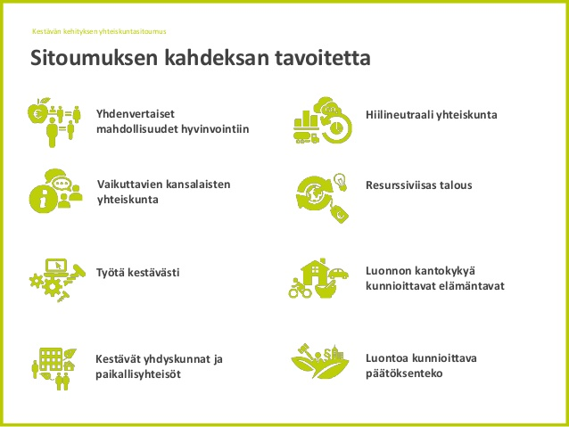
Society’s Commitment to Sust. Dev.
+ the 2030 Agenda

Slide 4
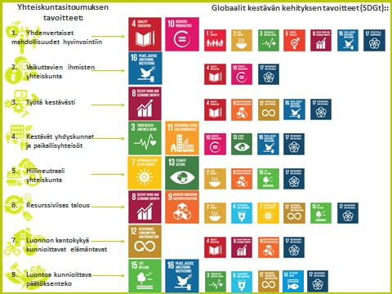
Integrated Long-term Vision for Sustainable Development

Slide 5
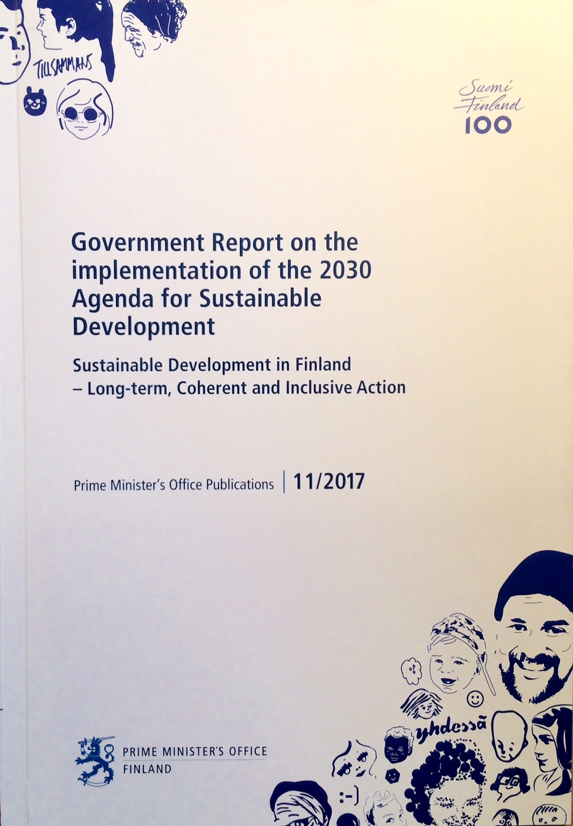
Government’s 2030 Agenda Implementation Plan
Focus Areas:
1. A carbon-neutral and resource-wise Finland
2. A non-discriminating, equal and competent Finland

Slide 6
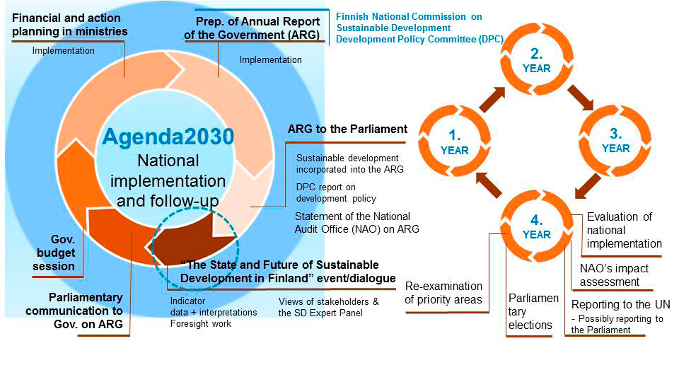

Slide 7
How to Implement the 2030 Agenda?
Key Components
LONG-TERM GOALS
PRINCIPLES:
Long-term perspective
Policy Coherence for Sustainable Development
Inclusive participation
DATA AND
EVIDENCE
DAY-TO-DAY POLICY MAKING
AND POLITICS

