Slide 1

IMPLEMENTATION OF THE Agenda 2030 in the Czech Republic
Office of the Government of the Czech Republic
Government Council for Sustainable Development
How we can achieve the SDGs? – The way to sustainability
Ideas, challenges and actions in
Europe and Austria
Vienna, 1 June 2017
Aneta Haimannová
Office of the Government of the Czech Republic
Sustainable Development Department
haimannova.aneta@vlada.cz

Slide 2
First Analysis of SDGs relevance
Office of the Government of the Czech Republic
Sustainable Development Department
(109 nationally
relevant targets)
Source: analysis of think-tank Glopolis (www.glopolis.org), October 2015

Slide 3
Responsibility for relevant targets
Office of the Government of the Czech Republic
Sustainable Development Department
Source: analysis of think-tank Glopolis (www.glopolis.org), October 2015

Slide 4
Integrated approach
Office of the Government of the Czech Republic
Sustainable Development Department
Institutional setting: Government Council for Sustainable Development under Prime Minister’s Office
Main challenges:
  Integrated approach demands strong coordination capacity (Centre of Government) and leadership
  Universality of the Agenda demands awareness-raising among ministries which are not yet familiar with the topic
  New way of approaching the vertical coordination (from local to global level)
  Network approach to engage all relevant stakeholders – the changing identity of public administration

Slide 5
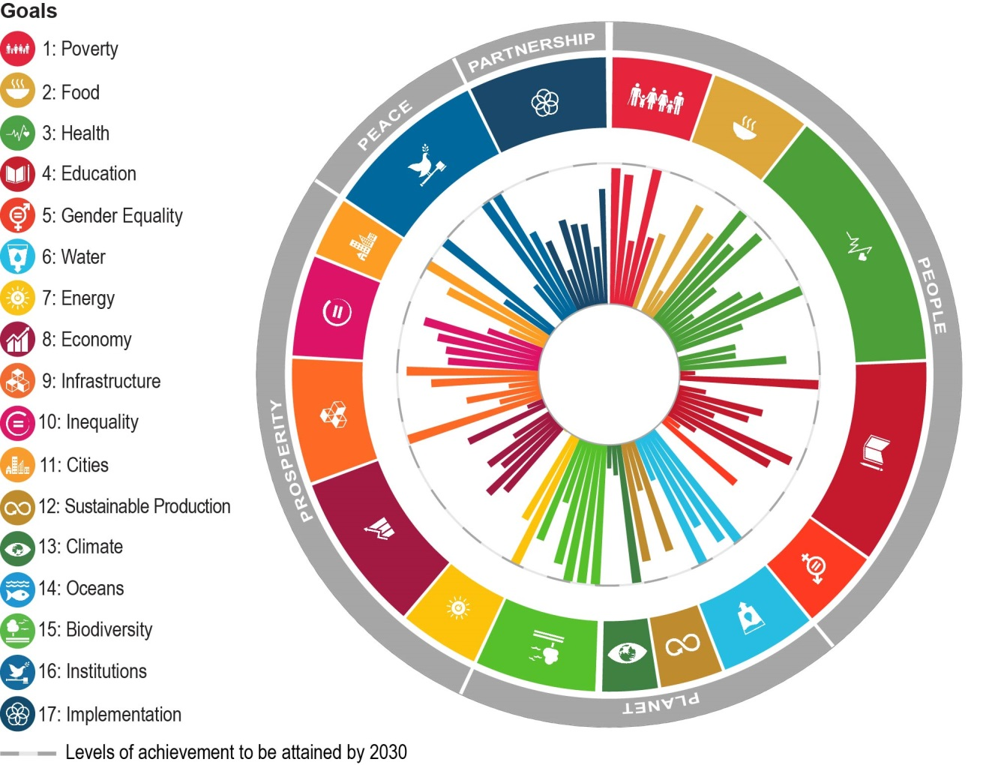
OUR Starting point
Office of the Government of the Czech Republic
Sustainable Development Department
Source: OECD, 2017

Slide 6
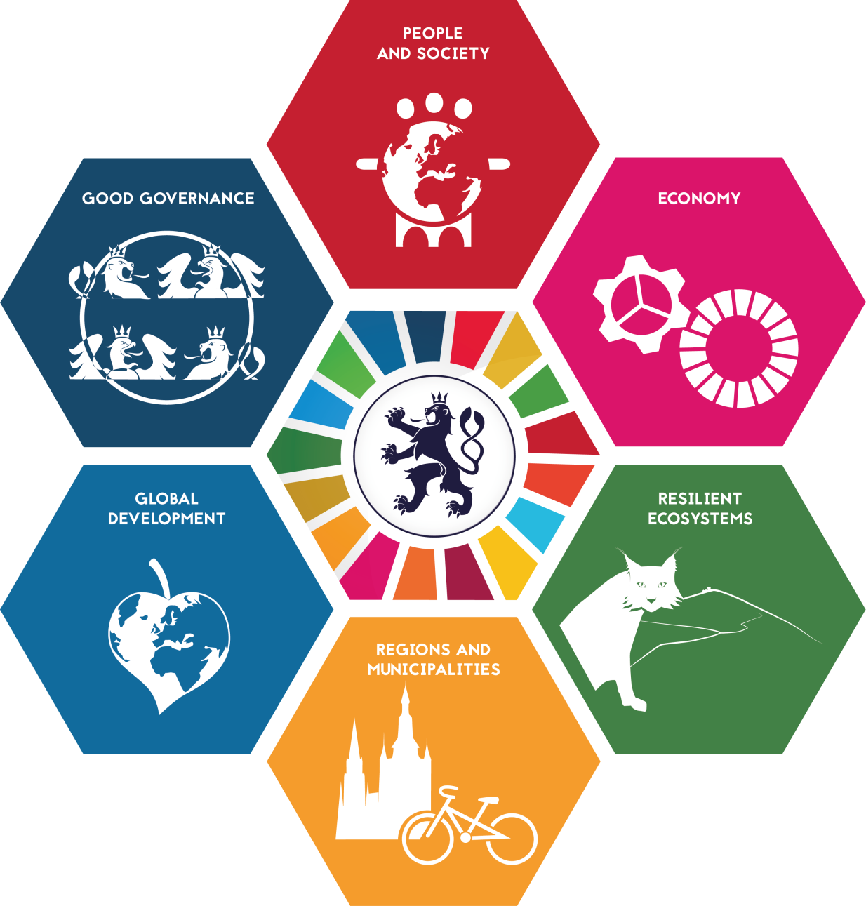
The Czech republic 2030
Office of the Government of the Czech Republic
Sustainable Development Department
  Adopted by the Government
  in April 2017

Slide 7
The Czech republic 2030
Office of the Government of the Czech Republic
Sustainable Development Department
Revision of the Strategic Framework for Sustainable Development (2010)
Concept of well-being and sustainability as a central perspective of the strategy (OECD’s Well-Being Framework adapted for the Czech Republic)
Integrates the implementation of the Agenda 2030, supports commitments of Paris Agreement, Sendai framework
„Umbrella“ framework for sectoral, regional and local strategies
Identifies six key areas for the development of the Czech Republic and sets strategic and specific goals – cluster approach
Global megatrends as context for development
Participation and multistakeholder partnership as key principles in drafting and implementation of the document

Slide 8
Stakeholders Engagement
Office of the Government of the Czech Republic
Sustainable Development Department
Sustainable Development Department
Ministries
9 Committees of the Government Council for Sustainable Development
Government Council for Sustainable Development
Other actors (NGOs, private sector, academia)

Slide 9
Implementation of the Czech Republic 2030
Office of the Government of the Czech Republic
Sustainable Development Department
Czech Republic 2030
Strategic goal
Specific goal
Specific goal
Sectoral and regional strategies
Measure
Measure
Measure
Measure

Slide 10
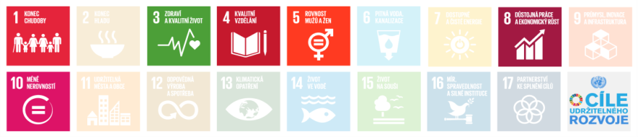
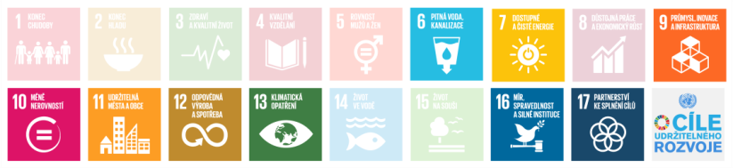
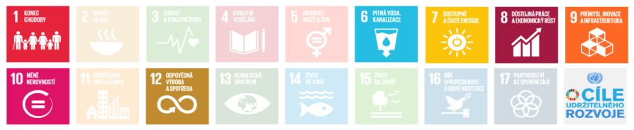
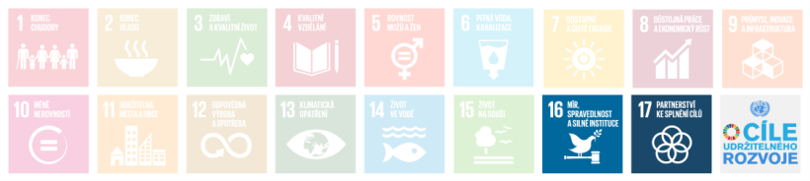
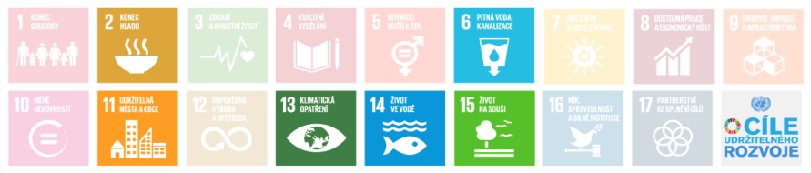
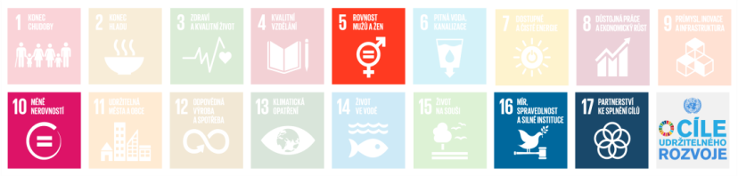
Compatibility with sdgs and targets
Office of the Government of the Czech Republic
Sustainable Development Department
Leading role of the Government Office to ensure alignment of the SDGs and targets with the 6 key areas
People and society
Municipalities
Economic model
Global development
Resilient ecosystems
Good governance

Slide 11
Compatibility with sdgs and targets
Office of the Government of the Czech Republic
Sustainable Development Department
Analysis of the relevance of SDGs (national agenda)
  Applicability in the Czech Republic (YES / NO)
  Has the target been already met? (YES / NO)
  Authority responsible for implementation
  Analytical Comments
  Summary for the SDG
Policy analysis – alignment with the goals and targets of Agenda 2030, monitoring and progress tracking (OECD Pilot Study on SDGs)

Slide 12
Monitoring and reporting
Office of the Government of the Czech Republic
Sustainable Development Department
Czech Republic 2030
Biannual Report on Quality of Life and Its Sustainability.
180 indicators related to specific goals of the Czech Republic 2030
Parallel process – preparation of well-being indicators (based on OECD’s Well-Being Framework – through 11 expert focus groups
Revision (at minimum) every 5 years
„Shadow“ reporting (NGOs)
Voluntary Committment Framework
Agenda 2030
Voluntary National Review presentation at the HLPF 2017
Regular reporting carried by the National Statistical Office

Slide 13
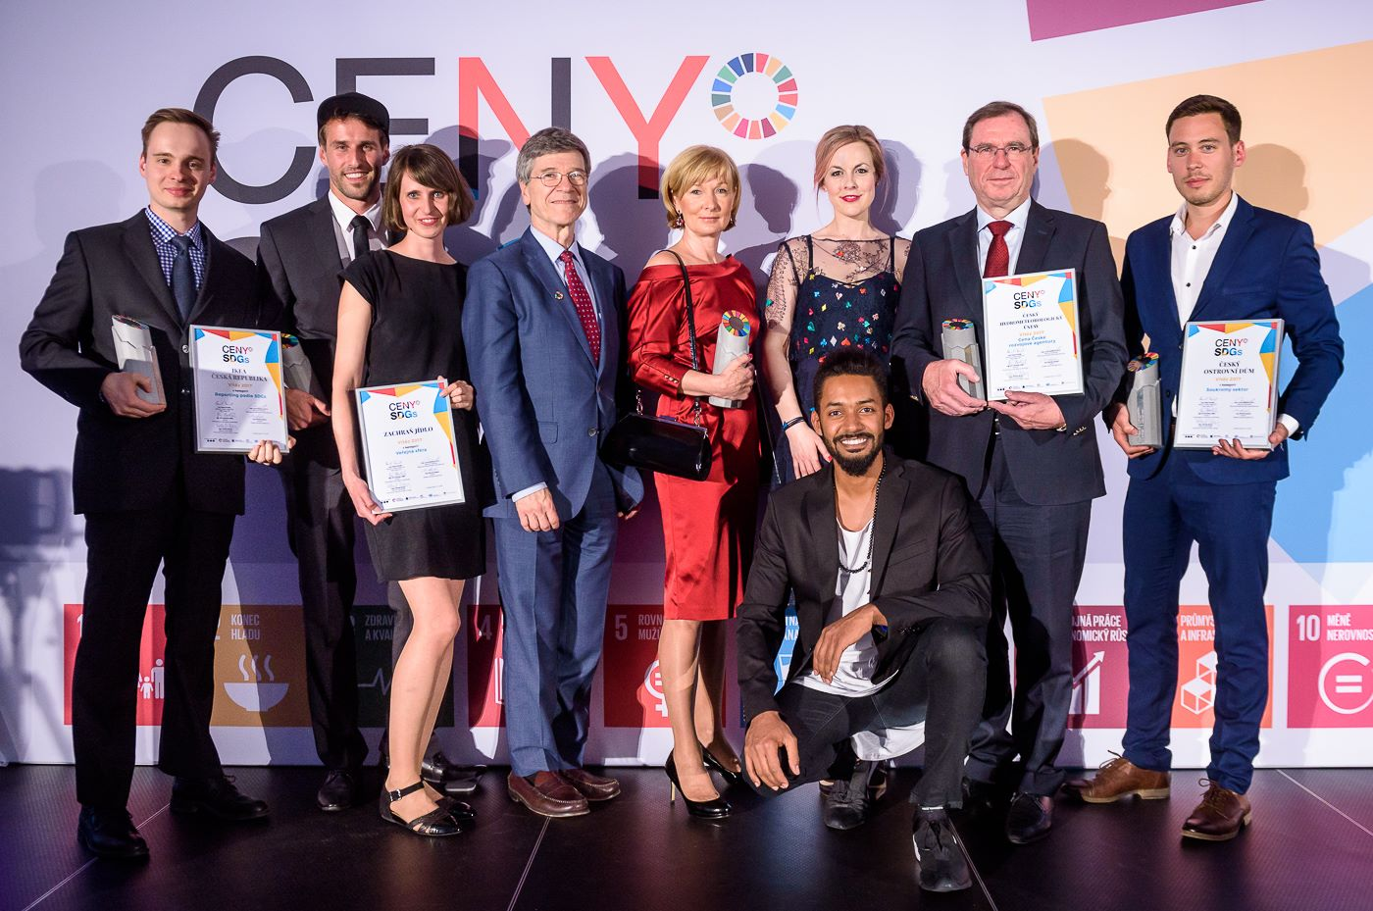
NEXT STEPS
Office of the Government of the Czech Republic
Sustainable Development Department
Implementation of the Czech Republic 2030
Policy coherence for sustainable development
Strategic foresight
Raising awareness about the SDGs, getting other actors on board
The Czech SDGs Awards

Slide 14
Office of the Government of the Czech Republic
THANK YOU FOR YOUR ATTENTION

